Slide 1
TERMS AND CONDITIONS
These PowerPoint slides are a tool for lecturers, and as such:
YOU MAY add content to the slides, delete content from the slides, print out the slides, and save the slides onto your computer or server.
YOU MAY NOT resell, reproduce or redistribute the content in any form whatsoever, without prior written permission from the copyright holder.
© Troupant Publishers (Pty) Ltd, 2016
Selected images used under licence from Shutterstock.com

Slide 2
Engineering Systems
NQF Level 2

Slide 3
Mechanical systems
Module 3

Slide 4
Mechanical systems and their components
Unit 3.1

Slide 5
Simple machines
A mechanical device that changes the direction or magnitude of a force.
The simplest mechanism that uses mechanical advantage, also called leverage, to multiply force.

Slide 6
Simple machines
Six types:
Levers.
Wheels and axles.
Pulleys.
Inclined planes.
Wedges.
Screws.

Slide 7
Levers
A lever is a simple machine that consists of a rigid object such as a bar, and a fulcrum or pivot.

Slide 8
Levers
First-class levers
Figure 3.1 A simple first-class lever

Slide 9
Levers
Second-class levers
Figure 3.2 A simple second-class lever

Slide 10
Levers
Third-class levers
Figure 3.3 An arm is an example of a third-class lever

Slide 11
Wheels and axles
The simplest form of a wheel and axle consists of a rod attached to a wheel so that their movements are couples – when one part turns, the other part also turns.
Used as a force multiplier or a distance multiplier.

Slide 12
Wheels and axles
wheel
axle
Figure 3.4 Examples of wheel and axle

Slide 13
Pulleys
A pulley is a wheel with a groove into which a rope or cable can be placed.
Used to reduce the force that must be applied to move an object.

Slide 14
Pulleys
Simple pulleys
Figure 3.5 A simple pulley system

Slide 15
Pulleys
Two-pulley systems
Figure 3.6 A two-pulley system

Slide 16
Inclined planes
An inclined plane is a flat, slanted surface.
By moving an object up an inclined plane rather than a vertical plane, the amount of force required is reduced.

Slide 17
VIDEO: Pulley

Slide 18
Inclined planes
Figure 3.7 An inclined plane

Slide 19
Wedges
A wedge is a piece of wood, metal or other material with a thick end that tapers to a thin end.
A wedge is used to separate objects, lift an object or hold an object in place.

Slide 20
Wedges
Figure 3.8 The claw of a hammer
is an example of a wedge

Slide 21
Screws
A screw is a cylindrical shaft with helical grooves or ridges called threads around the outside.
A screw converts a rotational motion to a linear motion and a torque (rotational force) to a linear force.

Slide 22
Screws
Figure 3.9 Jacking up a car

Slide 23
Summary of the effects of simple machines
Table 3.1 Effects of simple machines

Slide 24
Mechanical advantage
A machine makes work easier by increasing the amount of force you exert on an object.
This produces a mechanical advantage, which is the amount of force that is multiplied by the machine.

Slide 25
Mechanical advantage
Mechanical advantage (MA) = $\frac{output force}{input force}$
= $\frac{load}{effort}$
Mechanical advantage > 1 when: force is multiplied.
Mechanical advantage < 1 when: distance is multiplied.
Mechanical advantage = 1 when: direction is changed.

Slide 26
Velocity ratio
The ratio of the distance moved by the effort to the distance moved by the load in the same time.
Velocity ratio (VR) = $\frac{distance moved by the effort}{distance moved by the load}$

Slide 27
Friction
The difference between the calculated value and the real (actual) value of mechanical advantage is friction which is caused by the roughness of materials.

Slide 28
Efficiency
The efficiency of a machine compares the output work to the input work.
Efficiency is expressed as a percentage – the higher the percentage is, the more efficient the machine is.

Slide 29
Gears
Gears are compact power-transmission devices.
They consist of a pair of wheels with teeth that mesh.
They rotate together, and one gear wheel transfers motion and force to the other.

Slide 30
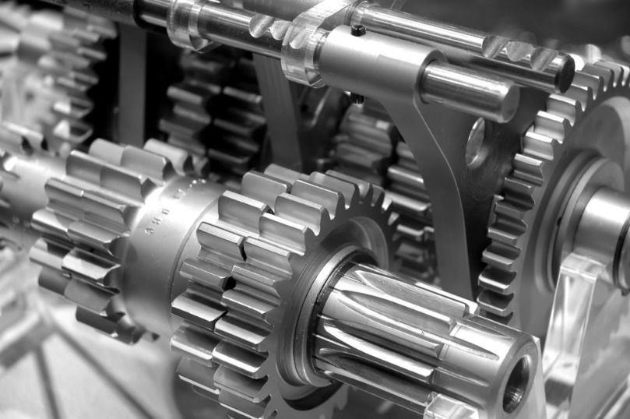
Gears
Figure 3.15 Gears used in a mechanical gearbox

Slide 31
Gears
Used to:
Change the direction of rotation.
Change speed and torque.
Prevent slippage.

Slide 32
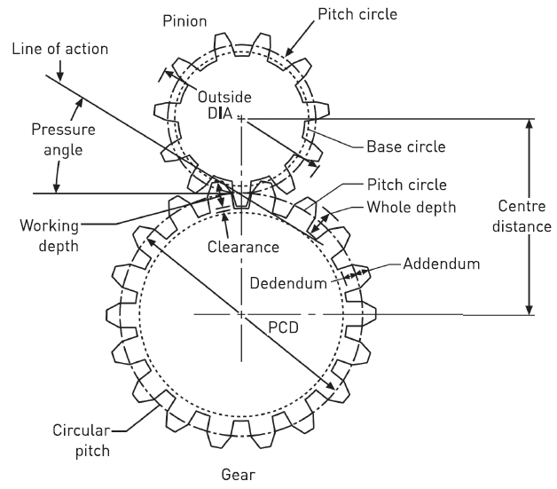
Gear terminology
Figure 3.16 Gear terminology

Slide 33
VIDEO: Gear train

Slide 34
Backlash
Backlash is the amount by which the width of a tooth space exceeds the thickness of the engaging tooth on the pitch circle.
I.e. the amount of clearance between mated gear teeth.

Slide 35
Backlash
Figure 3.17 Backlash

Slide 36
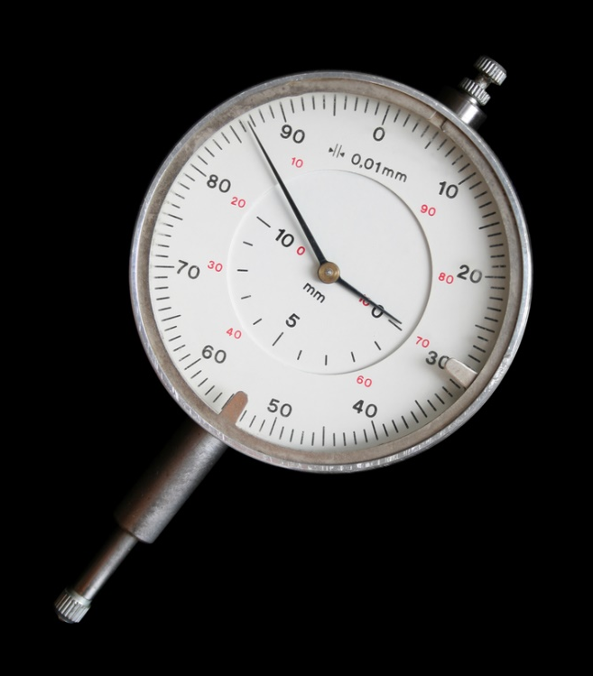
Backlash
Measuring backlash
a dial gauge.
a feeler gauge.
Figure 3.18 A dial gauge

Slide 37
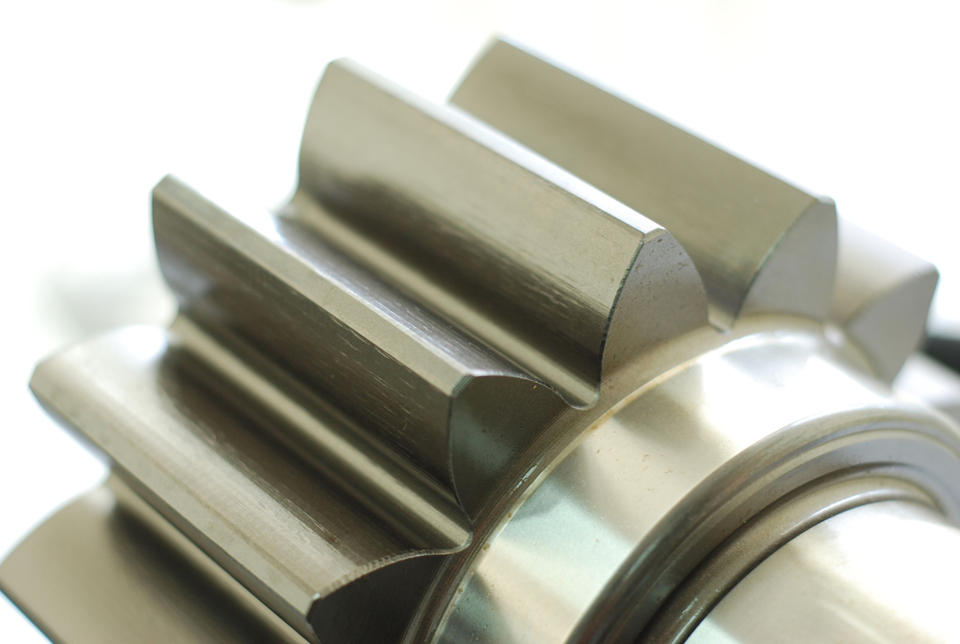
Gear types
Spur gears
Figure 3.19 A spur gear

Slide 38
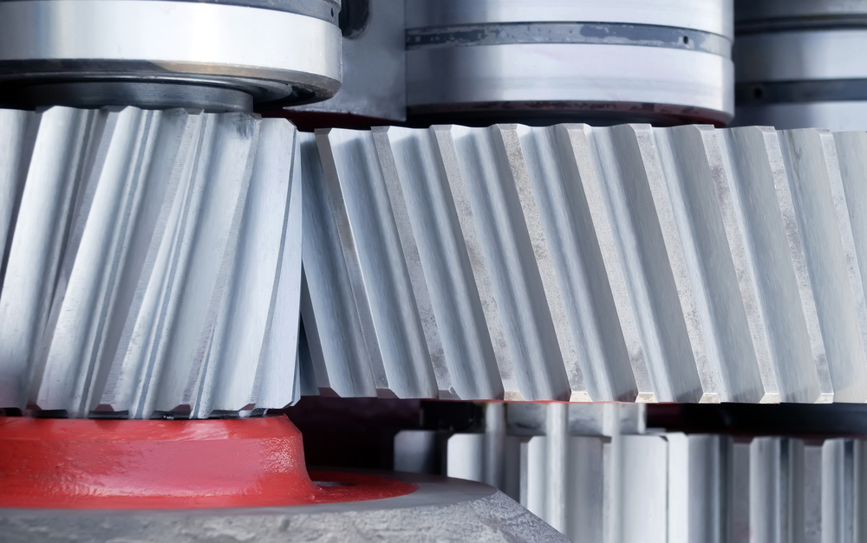
Gear types
Helical gears
Figure 3.20 A helical gear

Slide 39
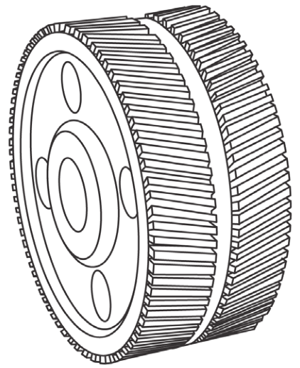
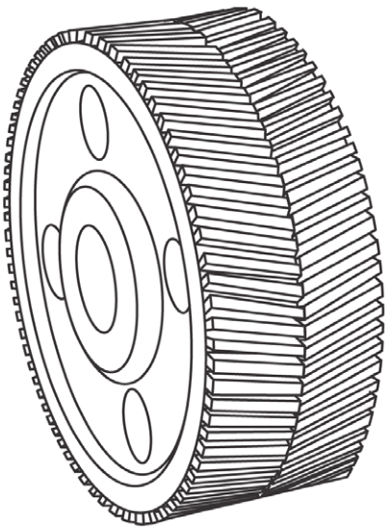
Gear types
Double helical gears or herringbone gears
Figure 3.21 Double helical gears with space between opposing sets of teeth
Figure 3.22 Double helical gears with no space between opposing sets of teeth

Slide 40
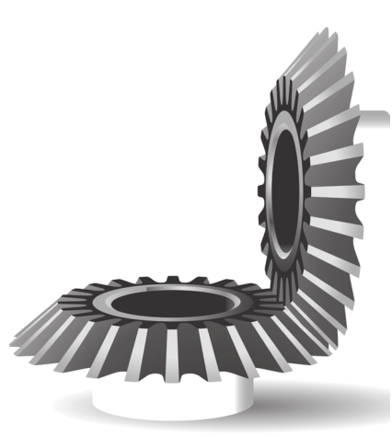
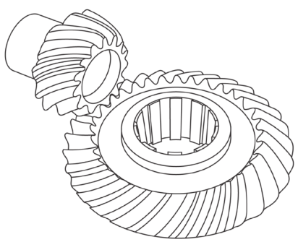
Gear types
Bevel gears
Figure 3.23 Straight tooth
bevel gears
Figure 3.24 Spiral bevel gears

Slide 41
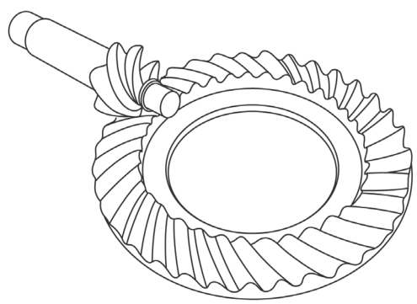
Gear types
Hypoid gears
Figure 3.25 Hypoid gears

Slide 42
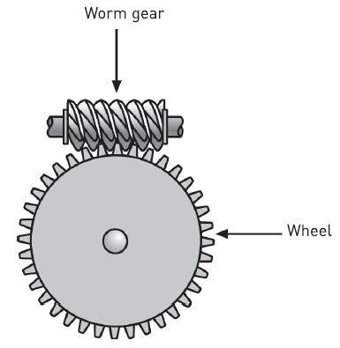
Gear types
Worm gears
Figure 3.26 A worm gear

Slide 43
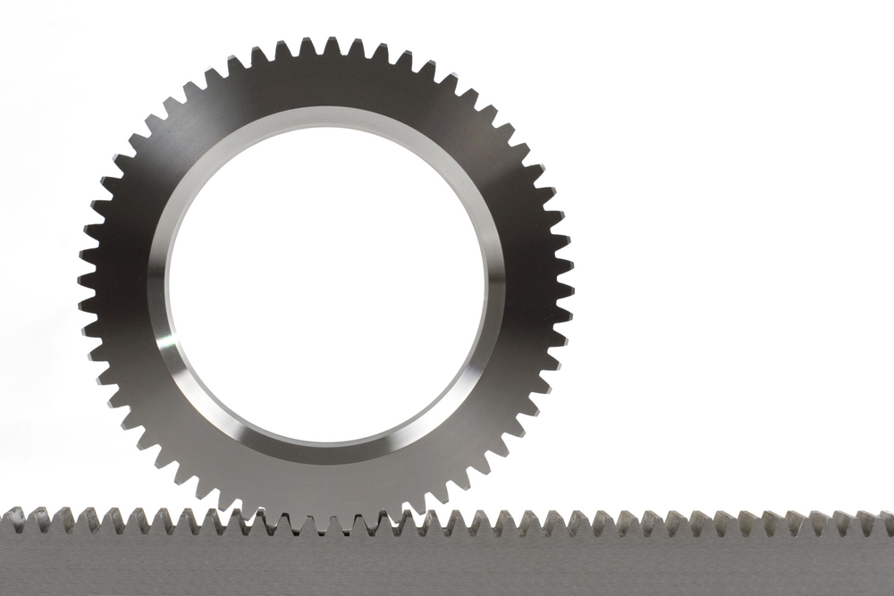
Gear types
Rack-and-pinion
Figure 3.27 A rack-and-pinion

Slide 44
Lubrication of gears
Gears should be lubricated to:
Minimise wear.
Prevent excessive heat generation.
Improve efficiency by reducing friction between the surfaces of the mating teeth.
Reduce noise.
Prevent rust.

Slide 45
Lubrication methods
Grease lubrication.
Splash lubrication (oil bath method).
Forced oil circulation lubrication.

Slide 46
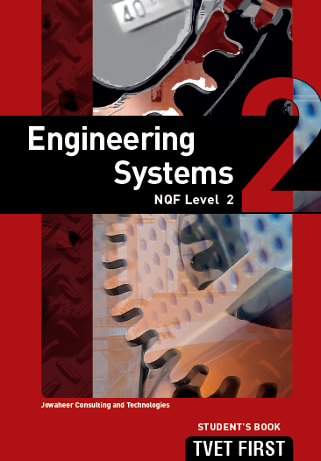
Summative assessment
Test your knowledge of this section by completing the Summative assessment (page 54 of your Student’s Book)

